Slide 1
MOEDL TRAINING USING REGRESSION

Slide 2
DATASET
The model is train on 4971 entries
It includes 9 independent variables
Year
Kilometers_Driven
Fuel_Type
Transmission
Owner_Type
Mileage
Engine Power
Seats
And one dependent variable Price
The dataset is train on 80% while tested on 20%

Slide 3
The following models of regression are trained on this dataset
Decision Tree Regression
Multi-linear Regression
Random forest Regression
Support Vector Regression

Slide 4
Points covered in EDA
Summary Statistics
Missing Values Analysis
Distribution of the Target Variable (Price)
Correlation Matrix (only numerical features)
Pair Plot (Numerical Features)
Box Plot for Outlier Detection
Count Plots for Categorical Features (Fuel_Type, Transmission, Owner_Type)
Plot for Fuel_Type,Transmission,Owner_type
Visiualization On Training and Testing Data

Slide 5
Explanation of Visualizations:
Correlation Matrix: Helps identify strong linear relationships between numerical features (e.g., Year, Kilometers_Driven, Mileage, etc.).
Pair Plot: Provides scatter plots for all numerical features and histograms to visualize individual distributions. It helps identify relationships and correlations.
Box Plot: Helps detect outliers in numerical features. If any feature has extreme values, they will be visible as points outside the boxes.
Count Plots: These plots show the distribution of categorical features (e.g., Fuel_Type, Transmission, Owner_Type). This helps understand the proportion of different categories in the dataset.

Slide 6


Slide 7

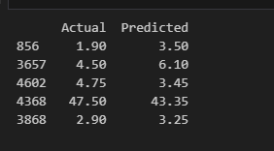
1.Decision Tree Regression
Using Decision tree regression gives mean squared and R squared values as under

Slide 8
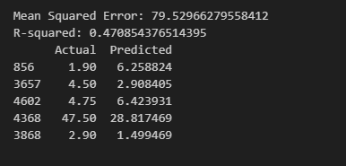
2.Multi Linear regression

Slide 9
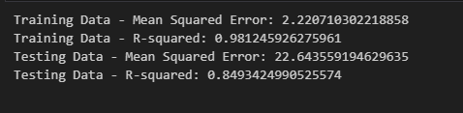
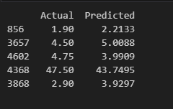
3.Random Forest Regression

Slide 10

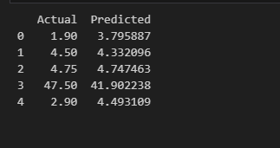
4.Support Vector Regression

